Slide 1
Heart Disease Prediction
Syed Bilal Rizwan - 23943
Wasila Rehman - 12348

Slide 2
About 610,000 people die of heart disease in the United States every year–that’s 1 in every 4 deaths.

Slide 3
Problem Statement
It is difficult to identify heart disease because of several contributory risk factors such as diabetes, high blood pressure, high cholesterol, etc.
Our goal is to apply Machine Learning approaches for classifying whether a person is suffering from heart disease or not.

Slide 4
Data Source & Size
2020 annual CDC telephone survey data of 400k adults related to their health status.
https://www.kaggle.com/datasets/kamilpytlak/personal-key-indicators-of-heart-diseasents.
This dataset has 319795 rows × 18 columns.

Slide 5
Column Descriptions
HeartDisease: Respondents that have ever reported having coronary heart disease (CHD) or myocardial infarction (MI).
BMI: Body Mass Index (BMI).
Smoking: Have you smoked at least 100 cigarettes in your entire life?
AlcoholDrinking: Heavy drinkers (adult men having more than 14 drinks per week and adult women having more than 7 drinks per week
Stroke: (Ever told) (you had) a stroke?
PhysicalHealth: Now thinking about your physical health, which includes physical illness and injury, for how many days during the past 30 days was your physical health not good? (0-30 days).

Slide 6
Column Descriptions
MentalHealth: Thinking about your mental health, for how many days during the past 30 days was your mental health not good? (0-30 days).
DiffWalking: Do you have serious difficulty walking or climbing stairs?
Sex: Are you male or female?
AgeCategory: Fourteen-level age category. (then calculated the mean)
Race: Imputed race/ethnicity value.
Diabetic: (Ever told) (you had) diabetes?

Slide 7
Column Descriptions
PhysicalActivity: Adults who reported doing physical activity or exercise during the past 30 days other than their regular job.
GenHealth: Would you say that in general your health is...
SleepTime: On average, how many hours of sleep do you get in a 24-hour period?
Asthma: (Ever told) (you had) asthma?
KidneyDisease: Not including kidney stones, bladder infection or incontinence, were you ever told you had kidney disease?
SkinCancer: (Ever told) (you had) skin cancer?

Slide 8
Exploratory Data Analysis

Slide 9
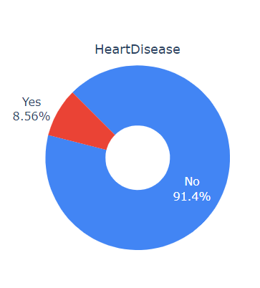
Highly Imbalanced Dependent Variable

Slide 10
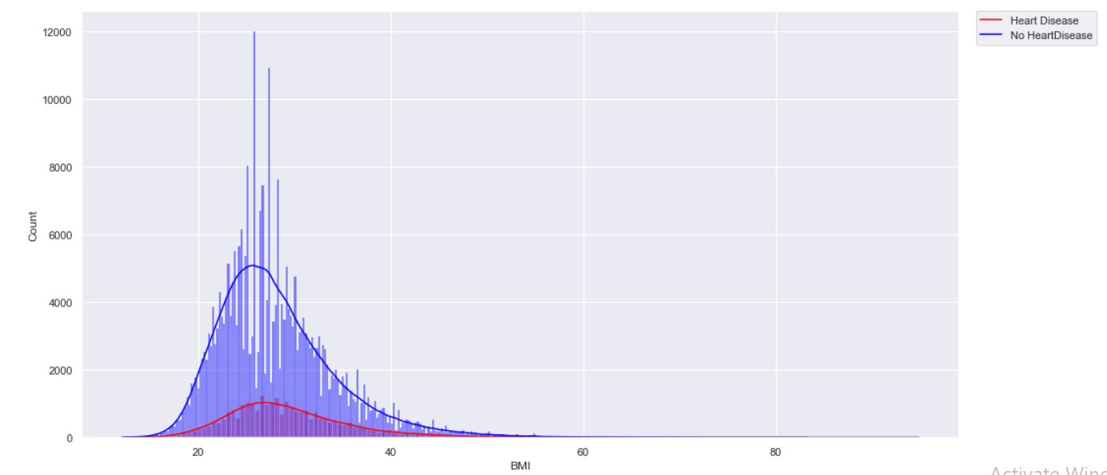
People with Heart Disease are found to have a higher BMI than people with no Heart Disease

Slide 11
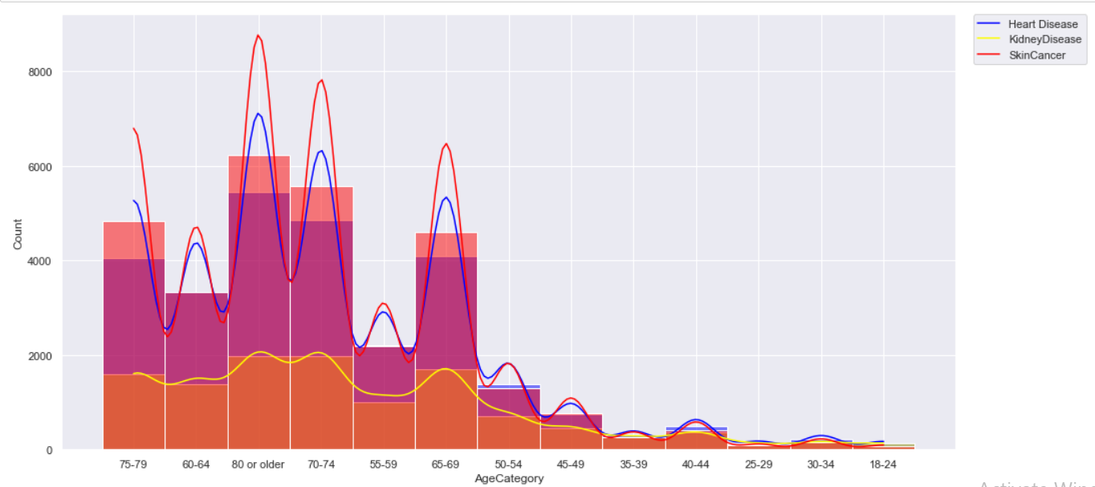
Majority of the records in our dataset have age over 60. As age groups increase, the occurrence of skin cancer, heart disease, and kidney disease also increase.

Slide 12
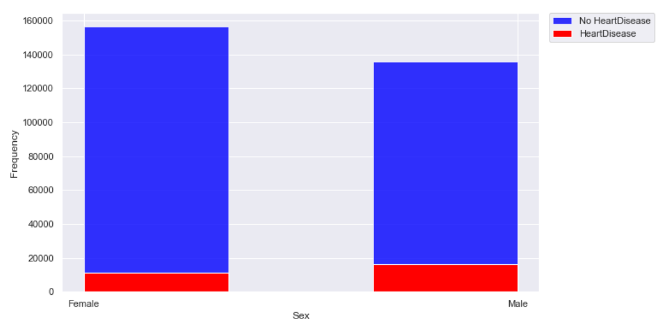
The probability of Males having heart disease is higher than Females.
Probability of Heart Diseases in Males: 0.106
Probability of Heart Diseases in Females: 0.067

Slide 13
Our Approach
Pre-processing the data
Creating Baseline models using Naïve Bayes, and ROC curve
Creating a sample of the dataset (0.35)
Hyperparameter tuning models on sample dataset
Finding best parameters for each model on full dataset
Balancing the dataset using SMOTE
Finding best parameters for each model on full dataset post SMOTE
Voting, Stacking Classifier
Deciding the best Model & Evaluation Metrics

Slide 14
Data Pre-Processing

Slide 15
Models Tried and Evaluation Metrics

Slide 16
Software Demo

Slide 17
Potential Beneficiary of our Project
Early detection of cardiac diseases can decrease the mortality rate and overall complications.
Available instruments which predict heart disease are expensive.
The hidden patterns can be used for health diagnosis by hospitals and doctors in medicinal data.

Slide 18
Challenges Faced & Way Forward
Negative Correlation between Recall & Precision
Highly Imbalanced data leads to inaccurate predictions
Trying SVM and extensive search of voting and stacking algos to get better accuracy
To increase the predictive power by trying deep learning

Slide 19
Thankyou

